Slide 1



PEILab Group Meeting
Leader: Zicong Hong
Team Member: Jian Lin, Haodong Wang, Qianli Liu, Kaibin Guo, Junjie Liu

Slide 2
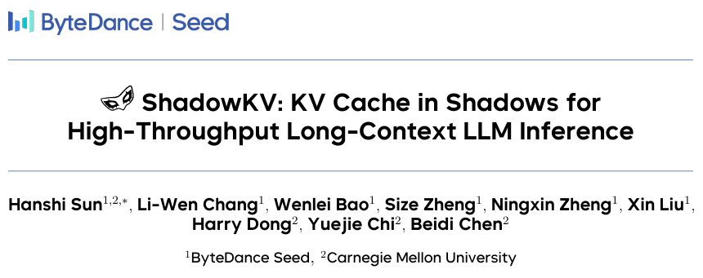
ShadowKV
ICML 2025(Spotlight)

Slide 3
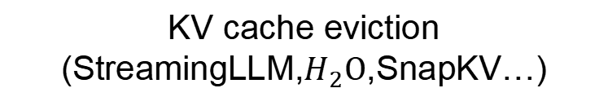
ShadowKV
Existing mothods
KV cache eviction
(StreamingLLM,$H_{2}O$,SnapKV…)
accuracy degradation
(especially muti-turn conversation)
Dynamic Sparse Attention
(SparQ,Quest…)
inadequate memory reduction
Offload the KV cache to CPU
(InfiniGen…)
significant decoding latency overhead
Objective
(i) reduce GPU memory usage
(ii) minimize inference latency
(iii) maintain accuracy within limited sparse KV cache budgets

Slide 4
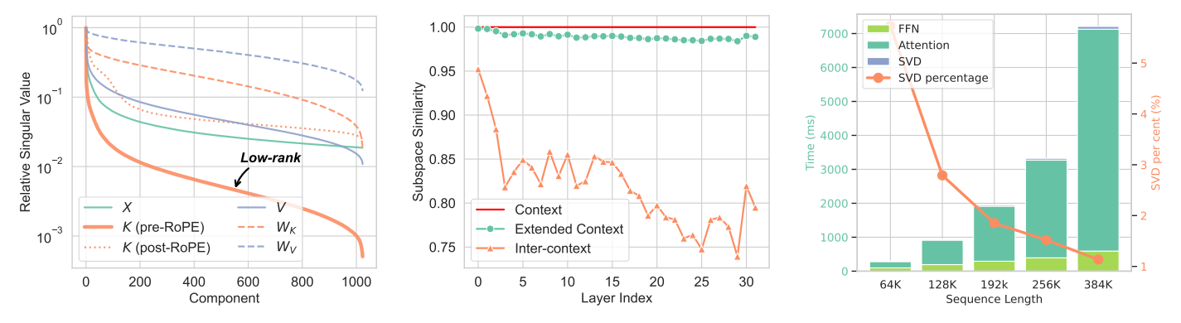
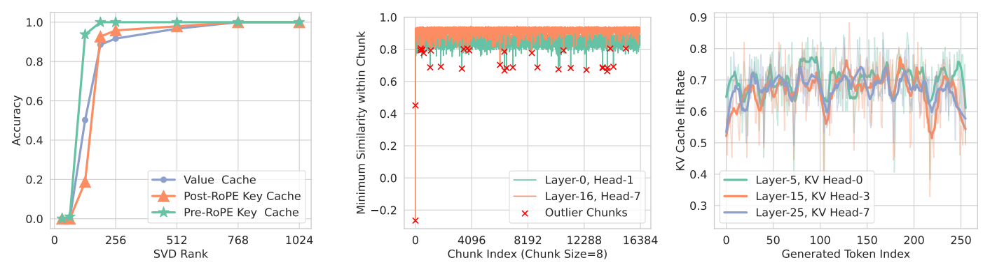
ShadowKV
Observations
Low-rank Keys and Offloaded Values for Storage
Accurate KV Selection for Fast Decoding

Slide 5
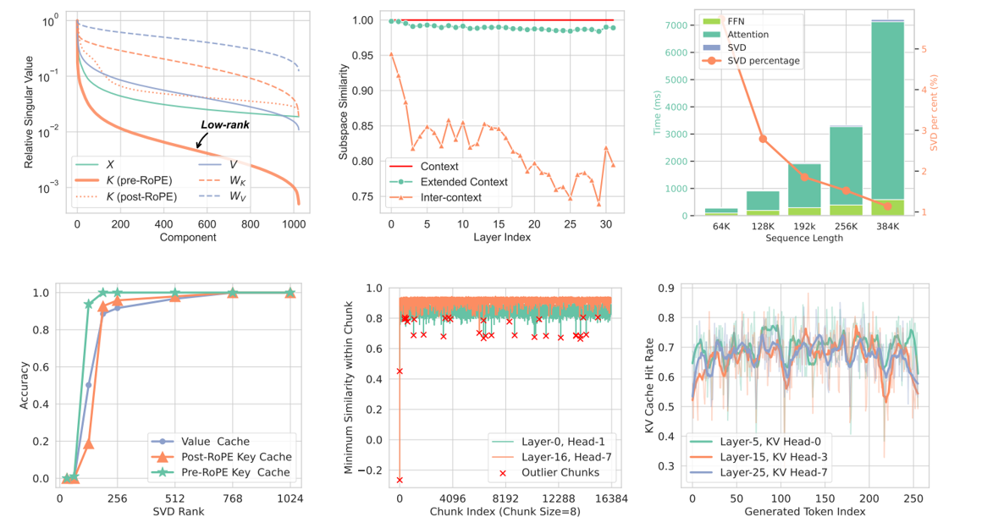
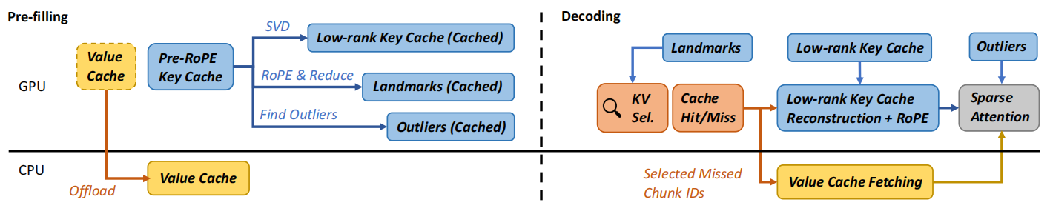
ShadowKV
Observations
Low-rank Keys and Offloaded Values for Storage
Accurate KV Selection for Fast Decoding
Algorithm

Slide 6
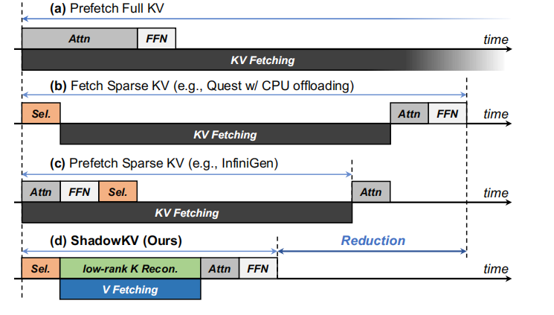
ShadowKV

Slide 7
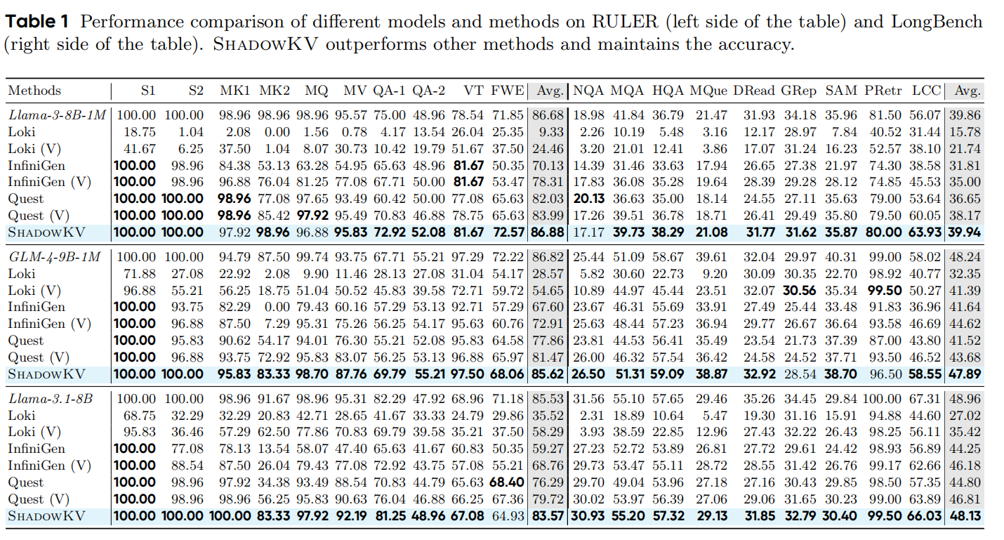
ShadowKV

Slide 8
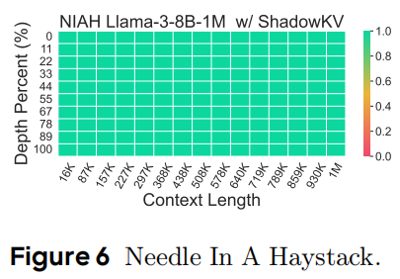
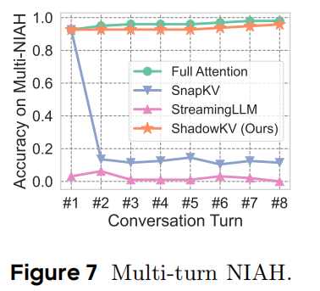
ShadowKV

Slide 9
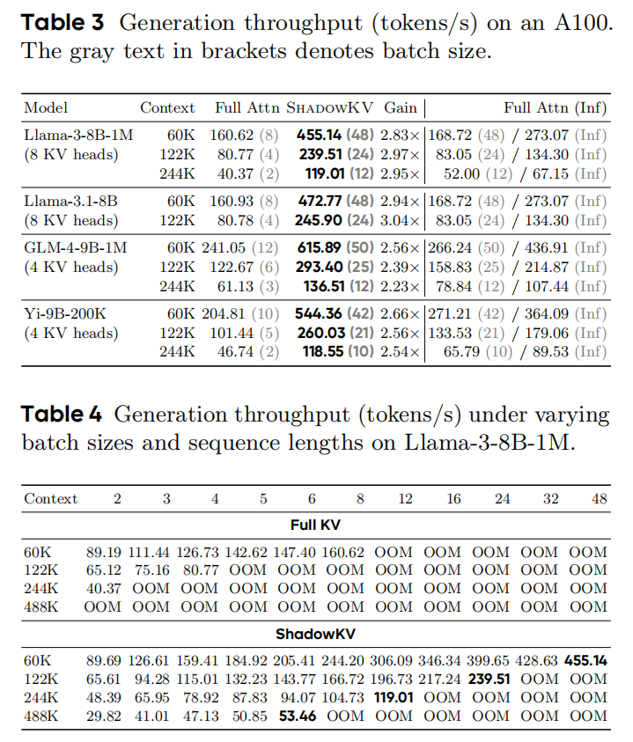
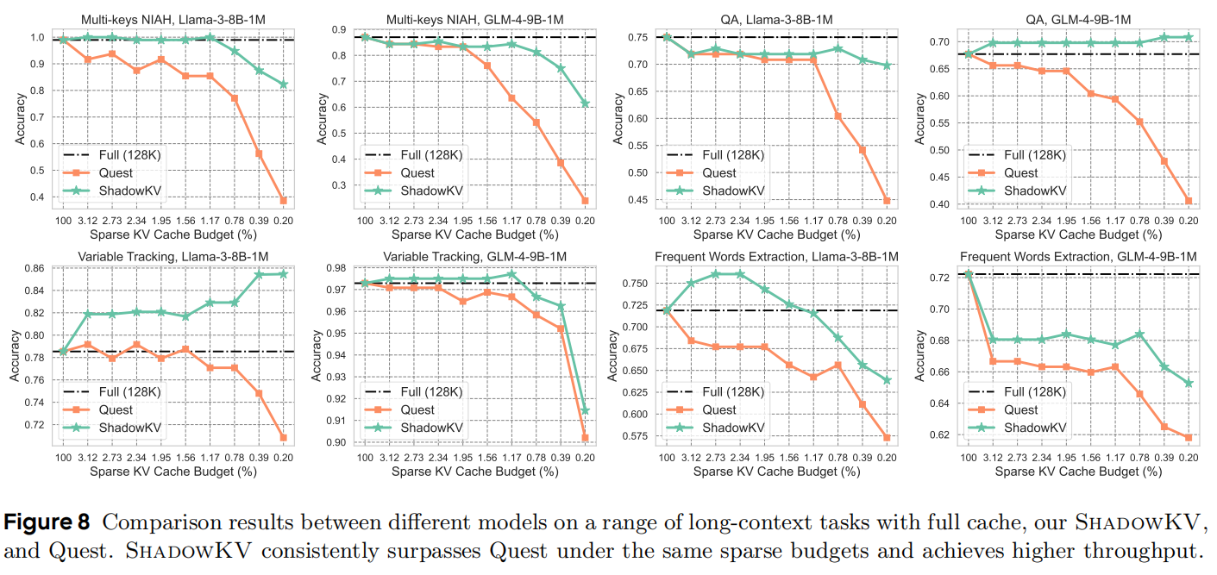
ShadowKV

